Slide 1
PHARMACOLOGY OF ADRENALINE, NORADRENALINE AND ISOPRENALINE PHA 302: AUTONOMIC NERVOUS SYSTEM
BY
Pharm F.A OLADOJA.
B.Pharm, M.Sc., ACISM(USA), ACIWM, ACA
Department of Pharmacology and Toxicology,
Faculty of Pharmacy,
Olabisi Onabanjo University.

Slide 2
.
ADRENALINE

Slide 3
ADRENALINE: BACKGROUND
Adrenaline is a hormone derived from tyrosine, an amino acid.
Adrenaline is also spelt adrenalin, and in North America is known by the name epinephrine.
Adrenaline/epinephrine, noradrenaline/norepinephrine and dopamine are classified as catecholamines
Adrenaline is a stress hormone and function as part of the 'fight or flight' response

Slide 4
ADRENALINE : BACKGROUND (CONTD)
Adrenaline is produced by the chromaffin cells in the medulla of the adrenal glands
Adrenaline is released in response to a stressor or perceived threat. This stressor can be emotional, physical or environmental
The steps to the adrenaline response and release are as follows:
A stressor is perceived
This stimulates signals to the brain
The brain sends signals to the chromaffin cells of the adrenal glands
Adrenaline is released

Slide 5
ADRENALINE : BACKGROUND (CONTD)
The release of adrenaline activates specific physiological reactions, which are intended to prepare the body to respond to the perceived stressor or threat.
The responses include:
Stimulation of the liver to break down glycogen into glucose (to provide quick energy to the body)
Relaxation of the smooth muscles in the lungs and respiratory tract to enhance inspiration and lung capacity

Slide 6
ADRENALINE : BACKGROUND (CONTD)
Stimulation of the beta-adrenergic receptors in the myocardium to increase cardiac contractility and heart rate
Contraction of the arteries in the skin to divert blood flow
Contraction of the smooth muscles in the skin, causing the hairs to raise on the skin surface (goosebumps)

Slide 7
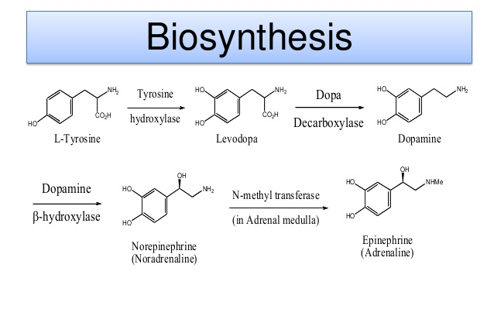
BIOSYNTHESIS OF ADRENALINE

Slide 8
MECHANISM OF ACTION
Adrenaline acts on alpha and beta-adrenergic receptors.
Adrenaline is the strongest alpha receptor activator.
Through its action on alpha-adrenergic receptors, Adrenaline minimizes the vasodilation and increased the vascular permeability that occurs during anaphylaxis, which can cause the loss of intravascular fluid volume as well as hypotension.

Slide 9
MECHANISM OF ACTION (CONTD)
Adrenaline relaxes the smooth muscle of the bronchi and iris and is a histamine antagonist, rendering it useful in treating the manifestations of allergic reactions and associated conditions
Adrenaline also produces an increase in blood sugar and increases glycogenolysis in the liver.
Through its action on beta-adrenergic receptors, adrenaline leads to bronchial smooth muscle relaxation that helps to relieve bronchospasm, wheezing, and dyspnoea that may occur during anaphylaxis

Slide 10
ADRENALINE: TARGETS
TARGET | ACTION | ORGANISMS
Alpha-1A adrenergic receptor | agonist | Humans
AAlpha-1B adrenergic receptor | agonist | Humans
Beta-1 adrenergic receptor | agonist | Humans
Beta-2 adrenergic receptor | agonist | Humans
Alpha-2A adrenergic receptor | agonist | Humans
Alpha-2B adrenergic receptor | agonist | Humans
Alpha-1D adrenergic receptor | antagonist | Humans
Tumour necrosis factor | antagonist agonist | Humans

Slide 11
PHARMACOKINETICS OF ADRENALINE
ABSORPTION :
Following I.V. (intravenous) injection, Adrenaline disappears rapidly from the blood stream.
Subcutaneously or I.M. (intramuscular) administered adrenaline has a rapid onset and short duration of action.
Subcutaneous (SC) administration during asthmatic attacks may produce bronchodilation within 5 to 10 minutes, and maximal effects may occur within 20 minutes.

Slide 12
PHARMACOKINETICS OF ADRENALINE
DISTRIBUTION:
Epinephrine is distributed to most tissues
it crosses the placenta,
it is secreted into milk,
but it does not cross the blood-brain barrier.

Slide 13
PHARMACOKINETICS OF ADRENALINE
METABOLISM:
Epinephrine is rapidly inactivated mainly by enzymic transformation to metanephrine or normetanephrine, either of which is then conjugated and excreted in the urine in the form of both sulfates and glucuronides.
Either sequence results in the formation of 3-methoxy-4- hydroxy-mandelic acid(vanillylmandelic acid, VMA)
Epinephrine is rapidly inactivated in the body mostly by the enzymes COMT (catechol-O-methyltransferase) and MAO (monoamine oxidase). The liver is abundant in the above enzymes

Slide 14
PHARMACOKINETICS OF ADRENALINE
EXCRETION:
The majority of the dose of epinephrine is seen excreted in the urine
About 40% of a parenteral dose of epinephrine is excreted in urine as metanephrine, 40% as VMA, 7% as 3-methoxy-4-hydroxyphenoglycol, 2% as 3,4-dihydroxymandelic acid, and the rest as acetylated derivatives.
These metabolites are excreted mainly as the sulfate conjugates and, to a lesser extent, the glucuronide conjugates.
Only small amounts of the drug are excreted completely unchanged

Slide 15
HALF LIFE OF ADRENALLINE
The plasma half-life is approximately 2-3 minutes.
However, when administered by subcutaneous or intramuscular injection, local vasoconstriction may delay absorption so that epinephrine's effects may last longer than the half-life suggests

Slide 16
PHARMACODYNAMICS OF ADRERNALINE
Adrenaline is a sympathomimetic drug.
Important effects of adrenaline include increased heart rate, myocardial contractility, and renin release via beta-1 receptors.
Beta-2 effects produce bronchodilation which may be useful as an adjunct treatment of asthma exacerbations as well as vasodilation, tocolysis, and increased aqueous humor production

Slide 17
INDICATIONS OF ADRENALINE
Adrenaline injection is indicated in the emergency treatment of allergic reactions (Type I)
Anaphylaxis to stinging insects (e.g., order Hymenoptera, which include bees, wasps, hornets, yellow jackets and fire ants) and biting insects (e.g., triatoma, mosquitos),
It is also used for idiopathic anaphylaxis or exercise-induced anaphylaxis.

Slide 18
INDICATIONS OF ADRENALINE
Adrenaline's cardiac effects may be of use in restoring cardiac rhythm in cardiac arrest due to various causes but is not used in cardiac failure or in haemorrhagic, traumatic, or cardiogenic shock
Adrenaline is used as a hemostatic agent

Slide 19
INDICATIONS OF ADRENALINE
It is also used in treating mucosal congestion of hay fever, rhinitis, and acute sinusitis; to relieve bronchial asthmatic paroxysms.
It is also used for resuscitation in cardiac arrest following anaesthetic accidents;
Used in simple (open angle) glaucoma.

Slide 20
INDICATIONS OF ADRENALINE
Adrenaline is used as an over the counter (OTC) agent for the intermittent symptoms of asthma, such as wheezing, tightness of chest and shortness of breath.
It is also used for the maintenance of mydriasis during intraocular surgery
Used for relaxation of uterine musculature and to inhibit uterine contractions.
Adrenaline injection can be utilized to prolong the action of local anesthetics

Slide 21
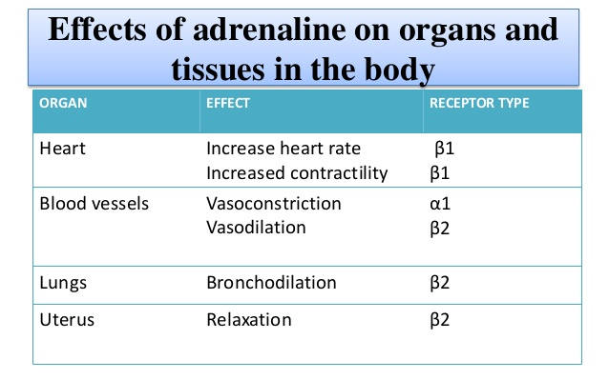
ORGAN SYSTEM EFFECTS

Slide 22
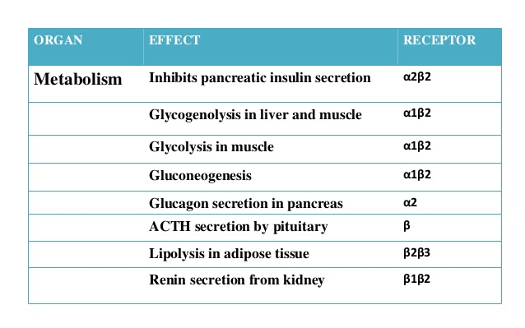
ORGAN SYSTEM EFFECTS

Slide 23
SIDE EFFECTS
Palpitations
Tremor
Light headedness
Tachycardia
Hypertension
Arrhythmias
Acute pulmonary edema
Lactic acidosis

Slide 24
CONTRAINDICATIONS
Known hypersensitivity
Hypertension
Ischaemic heart disease
Cardiac dilatation and insufficiency
Arrythmias
Diabetes mellitus
Narrow angle glaucoma#
Labour
Phaeochromocytoma

Slide 25
TOXICITY
Pregnancy
Adrenaline is teratogenic in rats when given in doses about 25 times the human doses.
It is unknown whether adrenaline can cause fetal harm when administered to a pregnant woman or can affect reproduction capacity.
Adrenaline should be given to a pregnant woman only if clearly required in critical situations/emergencies

Slide 26
TOXICITY
Labour and Delivery
Parenteral administration of epinephrine, if used as support for blood pressure during low or other spinal anaesthesia for delivery, can lead to the acceleration of fetal heart rate.
It should not be used in obstetrics when maternal blood pressure is higher than 130/80.
Epinephrine may delay the second stage of labour

Slide 27
TOXICITY
Cardiovascular effects:
Inadvertently induced high arterial blood pressure may result in angina pectoris (especially when coronary insufficiency is present), cardiac ischemia, or aortic rupture
Adrenaline may cause serious cardiac arrhythmias in patients not suffering from heart disease and patients with organic heart disease receiving drugs that sensitize the cardiac muscle

Slide 28
TOXICITY
Cerebrovascular hemorrhage:
Overdosage or accidental I.V. injection of adrenaline may lead to cerebrovascular haemorrhage resulting from the sharp rise in blood pressure
Renal vasoconstriction:
Parenterally administered adrenaline initially may produce constriction of renal blood vessels and decrease urine formation. High doses may cause complete renal shutdown
Pulmonary edema: Fatality may also result from pulmonary edema due to the peripheral constriction and cardiac stimulation produced by epinephrine injection

Slide 29
.
NORADRENALINE

Slide 30
NORADRENALINE :BACKGROUND
It is a catecholamine with multiple roles including as a hormone and a neurotransmitter
As a stress hormone, noradrenaline affects parts of the brain where attention and responding actions are controlled.
Noradrenaline also underlies the fight-or-flight response, directly increasing heart rate, triggering the release of glucose from energy stores, and increasing blood flow to skeletal muscle.
Noradrenaline can also suppress neuroinflammation when released diffusely in the brain from the locus ceruleus

Slide 31
NORADRENALINE :BACKGROUND
When norepinephrine acts as a drug it increases blood pressure by increasing vascular tone through α-adrenergic receptor activation.
The resulting increase in vascular resistance triggers a compensatory reflex that overcomes its direct stimulatory effects on the heart, called the baroreceptor reflex, which results in a drop in heart rate called reflex bradycardia

Slide 32
NORADRENALINE :BACKGROUND
Noradrenaline is synthesized from dopamine by dopamine β-hydroxylase.
It is released from the adrenal medulla into the blood as a hormone, and is also a neurotransmitter in the central nervous system and sympathetic nervous system where it is released from noradrenergic neurons.
The actions of noradrenaline are carried out via the binding to adrenergic receptors

Slide 33
NORADRENALINE :BACKGROUND
Noradrenaline is released when a host of physiological changes are activated by a stressful event.
In the brain, this is caused in part by activation of an area of the brain stem called the locus ceruleus.
This nucleus is the origin of most noradrenaline pathways in the brain.

Slide 34
BIOSYNTHESIS OF NORADRENALINE

Slide 35
MECHANISM OF ACTION
Norepinephrine functions as a peripheral vasoconstrictor by acting on alpha-adrenergic receptors.
It is also an inotropic stimulator of the heart and dilator of coronary arteries as a result of it's activity at the beta-adrenergic receptors.
Noradrenaline is frequently said to be a “pure” alpha-1 agonist. Some alpha-2 effect is also observed, and tends to mediate its effects on the tiny pre-capillary arterioles.

Slide 36
NORADRENALINE: TARGETS
Target | Actions | Organism
Alpha-1A adrenergic receptor | agonist | Humans
Alpha-1B adrenergic receptor | agonist | Humans
Alpha-1D adrenergic receptor | agonist | Humans
Alpha-2A adrenergic receptor | agonist | Humans
Alpha-2B adrenergic receptor | agonist | Humans
Alpha-2C adrenergic receptor | agonist | Humans
Beta-1 adrenergic receptor | agonist | Humans
Beta-2 adrenergic receptor | agonist | Humans
Beta-3 adrenergic receptor | agonist | Humans
Phenylalanine-4-hydroxylase | inhibitor | Humans
Synaptic vesicular amine transporter | binder | Humans
Chromaffin granule amine transporter | binder | Humans

Slide 37
PHARMACOKINETICS
Absorption
- Subcutaneous: Poor
- Oral: Noradrenaline is rapidly inactivated in the gastro-intestinal tract following oral administration.
- After intravenous administration Noradrenaline has a plasma half-life of about 1 to 2 minutes.

Slide 38
PHARMACOKINETICS
Distribution
Noradrenaline is rapidly cleared from plasma by a combination of cellular reuptake and metabolism.
Sympathetic nervous tissue
Crosses the placenta barrier
It does not readily cross the blood-brain barrier.

Slide 39
PHARMACOKINETICS
Biotransformation
Methylation by catechol-o-methyltransferase
Deamination by monoamine oxidase (MAO)
Ultimate metabolites from both is 4- hydroxy-3-methoxymandelic acid
Intermediate metabolites include normetanephrine and 3,4- dihydroxymandelic acid.
Elimination
Noradrenaline is mainly eliminated as glucuronide or sulphate conjugates of the metabolites in the urine.

Slide 40
PHARMACODYNAMICS
Noradrenaline acts on both alpha-1 and alpha-2 adrenergic receptors to cause vasoconstriction.
Its effect in-vitro is often limited to the increasing of blood pressure through antagonising alpha-1 and alpha-2 receptors and causing a resultant increase in systemic vascular resistance

Slide 41
INDICATIONS OF NORADRENALINE
Mainly used to treat patients in vasodilatory shock states such as septic shock and neurogenic shock and has shown a survival benefit over dopamine.
Also used as a vasopressor medication for patients with critical hypotension
Noradrenaline may also be used for attention-deficit hyperactivity disorder,(ADHD) and depression.
Noradrenaline, as with other catecholamines, itself cannot cross the blood-brain barrier, so drugs such as amphetamines are necessary to increase brain levels.

Slide 42
ADVERSE EFFECTS
Bradycardia
Tremor
Psychosis
Anxiety
Hypertension
Arrhythmias
Weakness
Anorexia
Nausea and Vomiting

Slide 43
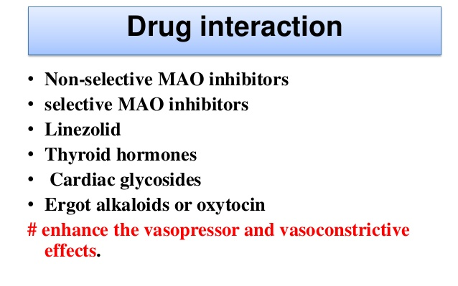
INTERACTIONS

Slide 44
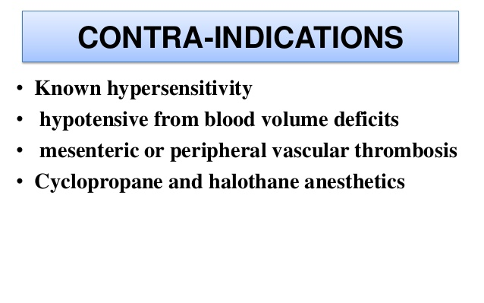
CONTRA-INDICATIONS

Slide 45
ASSIGNMENT
Discuss in full the Pharmacological properties of isoprenaline.

